Slide 1
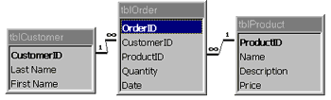
Mapping the Entity Diagram to a Relational Database
"What we don't understand, we cannot possess."
Slide # 4
Prof Yousef B. Mahdy

Slide 2

Topics
1. Review of relational databases
2. ER-to-relational mapping

Slide 3
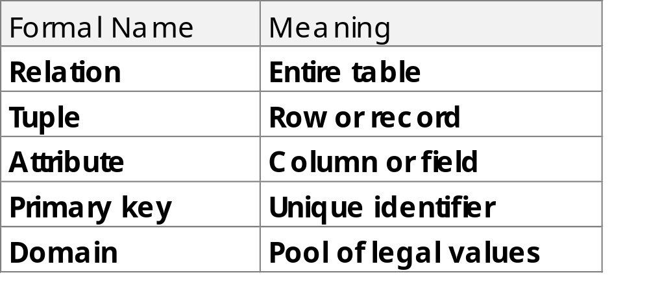
Definition of Relational Databases
C. J. Date: A relational database is a database that is perceived by its users as a collection of tables (and nothing but tables)

Slide 4
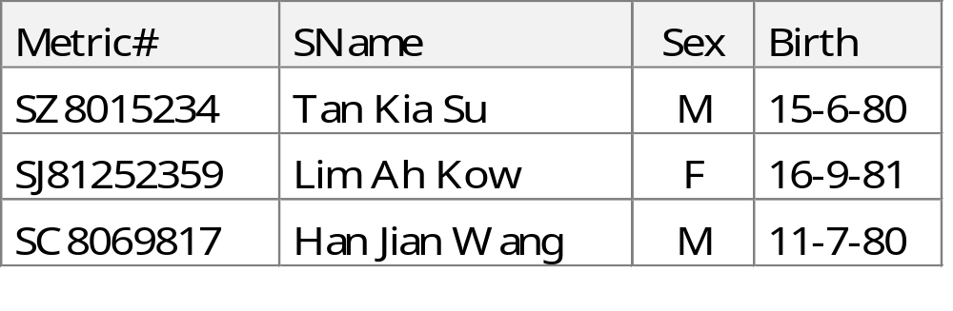
Brief Definition of Terminology
Metric# SName Sex Birth
Domains
M
F
Primary key
Attributes
Relation
Tuples
Cardinality
(no. of rows)
Degree (no. of cols)

Slide 5
Domain
Set of atomic values: smallest indivisible data in relational model
Has same data type and format
Domain of attribute is A_{i} denoted as dom(A_{i})
Attribute takes value from its domain
  E.g., attribute Sex takes values either M or F
Significance: If two attributes draw values from same domain, comparisons and other operations are possible

Slide 6

Relation
A relation on domains D₁, D₂, …, D_{n} consists of:
a heading (intension, relation schema, R)
  fixed set of attributes A₁, A₂, …, A_{n}
  each attribute A_{i} corresponds to one domain D_{i} (i = 1, 2,.., n)
  relatively static; rarely changed; only if new attribute added/deleted
a body (extension, relation instances, tuples, r(R))
  time varying set of tuples where each tuple consists of a set of values ⟨v₁, v₂, …, v_{n}⟩ where v_{i}, , is an element of dom(A_{i}) or null; null deals with incomplete information;

Slide 7
  degree of relation represented by n (unary, binary, ternary, …, n-ary)
  cardinality is number of tuples in relation
  formal definition: r(R) ⊆ (dom(A₁) × dom(A₂) × ··· × dom(A_{n})); i.e., r(R) is a subset of Cartesian product of domains that define R
  tuples dynamic in nature; changes to reflect real world situation
No need for domains to be distinct in a relation; e.g., home telephone number and office telephone number from domain TELNUM; country of birth, country of residence and country of citizenship from domain COUNTRY

Slide 8
Properties of Relation
No duplicate tuples: By definition, a set does not contain duplicate elements
No ordering: Similarly, by definition, elements of a set have no order
Attributes unordered: Attributes referenced by name rather than position (e.g., BirthDate attribute instead of 4th attribute)
Atomic attribute values: Every attribute value within a tuple is atomic (never a set of values)
Interpretation of relation: Relation schema or heading ≡ declaration or assertion of an entity type or relationship type; tuple or body ≡ fact (particular instance of assertion)

Slide 9
Keys
Superkey: Set of one or more attributes which uniquely identifies a tuple in relation
  E.g., Matric# can uniquely identify student; similarly, Matric# and SName is also superkey
  May contain some extraneous attributes; need not be minimal
  Every relation has at least one superkey

Slide 10
Candidate key (Minimal superkeys)
  Has no extraneous attributes
  Can have more than one candidate keys in a relation; e.g., EMPLOYEE relation may have the following candidate keys: Staff#, Office#, or Tel# (some assumptions made)
  In practice, usually only one candidate key is assigned to a relation

Slide 11
If R has attributes A₁, A₂, …, A_{n}, the set of attributes K = (A_{i}, A_{j}, …, A_{k}) is a candidate key if and only if these two time-independent properties hold:
  Uniqueness
  Minimality
Primary key(PK ): An arbitrary candidate key chosen to identify tuples
  Significance: combination of (R, k) where k is primary key, is the only way to reference/retrieve a particular tuple in a relation

Slide 12
Alternate key: Candidate keys other than primary key
Foreign key(FK ): An attribute (or attribute combination) in a relation R₂ where values must match with primary key of relation R₁; e.g., STUDENT and COUNSELLOR relations:
  STUDENT(Matric#, SName, Sex, BirthDate, Staff#)
  COUNSELLOR(Staff#, CName, Address)
Primary Key
Foreign Key

Slide 13
Integrity Constraints
Integrity constraints are specified on a DB schema and are expected to hold on every database state.
Integrity constraints that are part of relational model
  Entity integrity
  Referential integrity

Slide 14
The following example relations will be used:
  DEPT(Dept#, DName, Manager)
  EMP(Emp#, EName, Dept#, Salary)
Entity integrity
  No primary key value can be null
  Dept# and Emp# are PK for DEPT and EMP relations
  Null represents ‘information unknown’ or ‘property inapplicable’

Slide 15
  If Dept# or Emp# has value null
    (a) unable to identify some tuples (if two or more tuples have null primary keys)
    (b) contradictory; since PK acts as identifier, having a null identifier implies the entity or object does not exist
Referential integrity
  A tuple in one relation that refers to another relation must point to an existing tuple in that relation

Slide 16
  If R₂ has FK K₂ matching PK K₁ of R₁, then
    (a) each FK in R₂ must be equal to some PK in R₁ or
    (b) all attributes in FK are null
  Dept# in EMP is FK and Dept# in DEPT is corresponding PK
  Dept# values in EMP must match Dept# values in DEPT (i.e., EMP cannot work in non-existent departments)
  Possible for Dept# in EMP to be null; new employee may not be assigned to any department yet

Slide 17
Implications
  Entity integrity
    Prevent violation during database specification
    E.g., primary key is always “not null”; force user to always enter a value
  Foreign key
    Update
      Prevent creation of tuple if FK has no matching PK in other relation
    Delete
      An attempt to delete tuple containing PK
      Three possible actions: reject, cascades, nullifies

Slide 18
Summary of Integrity Constraints
Domain constraints
  Violated if attribute value does not appear in domain
Key constraints
  Violated if key value already exist in some tuple(s)
Entity integrity constraint
  Violated if key value is null
Referential integrity constraint
  Violated if FK value in referencing relation does not correspond to any PK value in referenced relation

Slide 19
7. ER-to-Relational Mapping
Various steps to produce a relational schema from an ER (EER) diagram
  Step 1: Regular entity types
  Step 2: Weak entity types
  Step 3: 1:1 relationship types
  Step 4: 1:N relationship types
  Step 5: M:N relationship types
  Step 6: Multivalued attributes
  Step 7: n-ary relationship types
  Step 8: Class hierarchies
  Step 9: Translating aggregations
Binary Relationship types

Slide 20
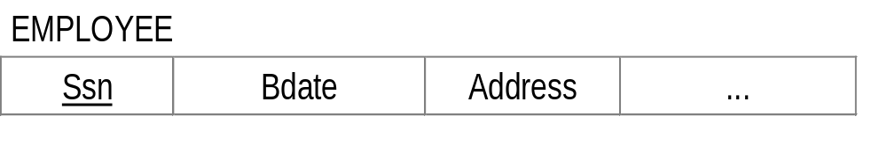
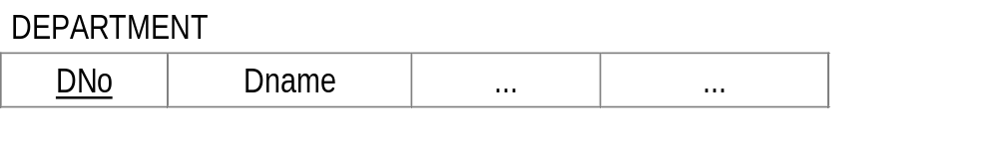
Step 1: Regular Entity Types
For each regular entity type E in ER diagram, create a relation R that includes all simple attributes of E
For a composite attribute, include only simple component attributes
Choose one key attribute of E as primary key for R
Example:
  Relations: EMPLOYEE, DEPARTMENT, PROJECT
  Primary keys: SSN, DNo, PNo

Slide 21
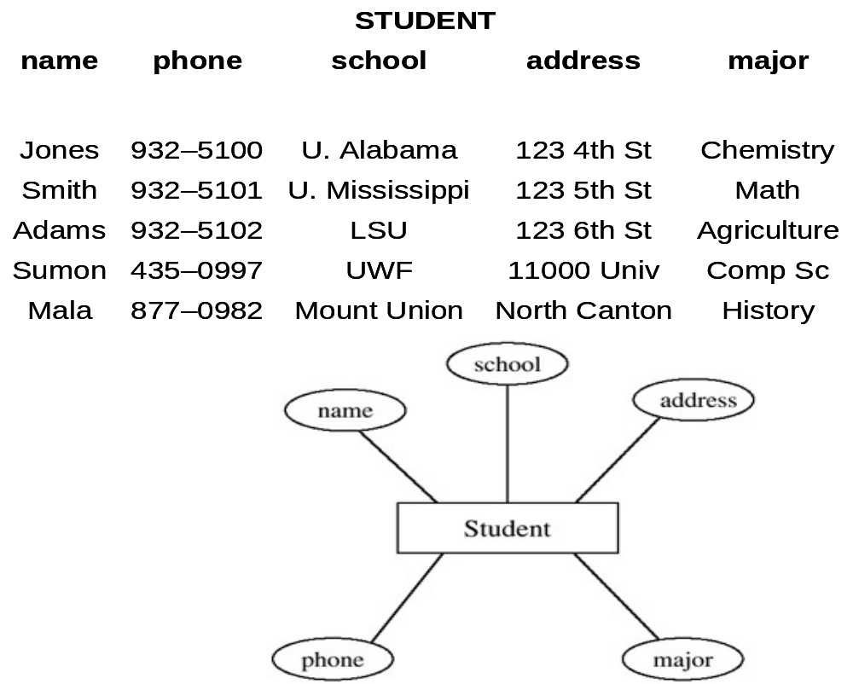
mapping atomic attributes from an entity — for entities with atomic attributes: map entities to a table by forming columns for the atomic attributes.

Slide 22
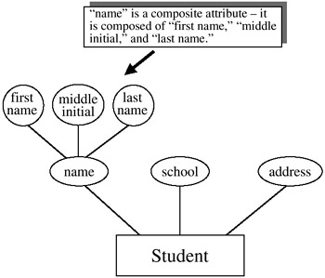
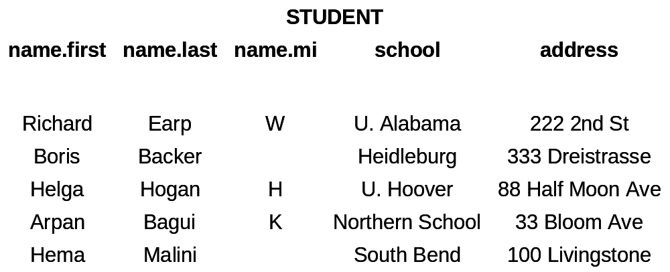
for entities with composite attributes: map entities to a table by forming columns from the elementary (atomic) parts of the composite attributes.

Slide 23
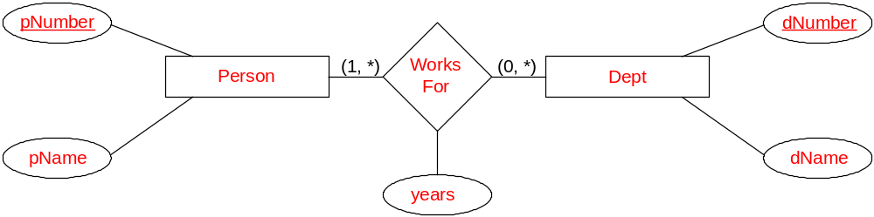
Example:
Person (pNumber, pName)
Dept (dNumber, dName)
WorksFor (pNumber, dNumber, years)
PRIMARY KEY (Person) = <pNumber>
PRIMARY KEY (Dept) = <dNumber>
PRIMARY KEY (WorksFor) = <pNumber, dNumber>
FOREIGN KEY WorksFor (pNumber) REFERENCES Person (pNumber)
FOREIGN KEY WorksFor (dNumber) REFERENCES Dept (dNumber)

Slide 24
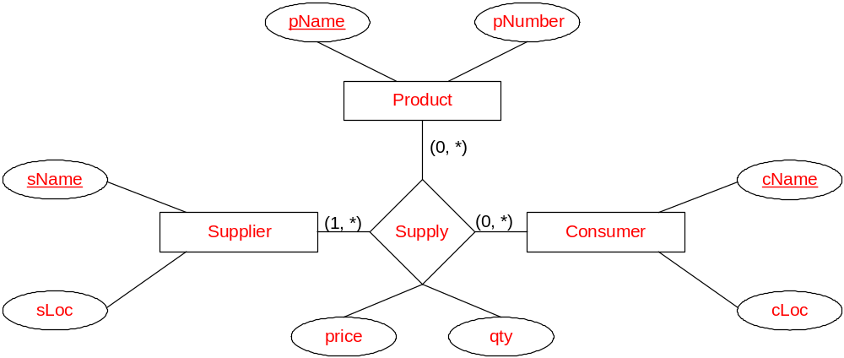
Example 2
Supplier (sName, sLoc)
Consumer (cName, cLoc)
Product (pName, pNumber)
Supply (supplier, consumer,
product, price, qty)
PRIMARY Key (Supplier) = <sName> PRIMARY Key (Consumer) = <cName>
PRIMARY Key (Product) = <pName>
PRIMARY Key (Supply) = <supplier, consumer, product>
FOREIGN KEY Supply (supplier) REFERENCES Supplier (sName)
FOREIGN KEY Supply (consumer) REFERENCES Consumer (cName)
FOREIGN KEY Supply (product) REFERENCES Product (pName)

Slide 25
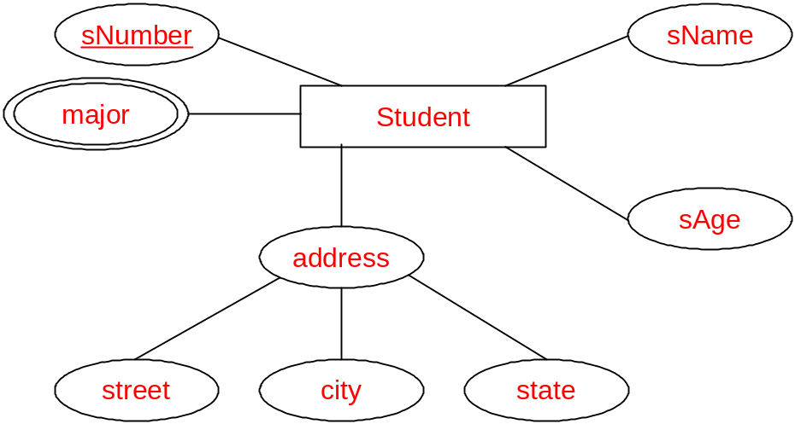
Composite and Multi-valued attributes in ER
Student (sNumber, sName, sAge, street, city, state)
StudentMajor (sNumber, major)
PRIMARY KEY (Student) = <sNumber>
PRIMARY KEY (StudentMajor) = <sNumber, major>
FOREIGN KEY StudentMajor (sNumber) REFERENCES Student (sNumber)

Slide 26
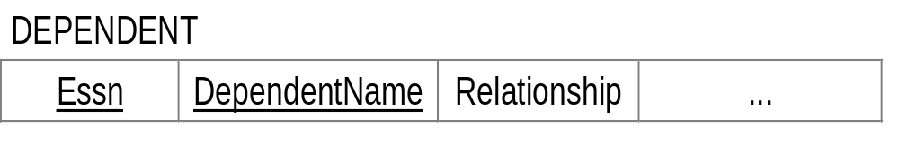
Step 2: Weak Entity Types
For each weak entity type W with owner entity type E, create a relation R whose attributes are all simple attributes of W
Primary key of owner entity type E becomes foreign key of R
Primary key of R is combination of primary key of owner type E and partial key of weak entity type W
Example:
  Relation: DEPENDENT
  Primary keys: ESSN (from EMPLOYEE) + DependentName (partial key)

Slide 27
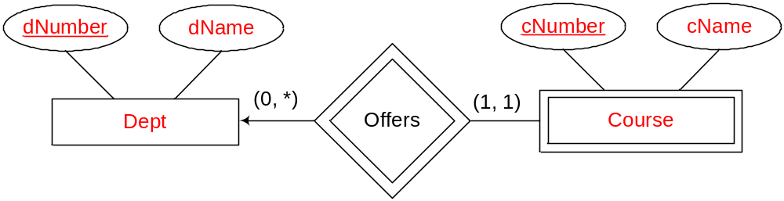
Weak entity types: Example
Dept (dNumber, dName)
Course (cNumber, dNumber, cName)
PRIMARY KEY (Dept) = <dNumber>
PRIMARY KEY (Course) = <cNumber, dNumber>
FOREIGN KEY Course (dNumber) REFERENCES Dept (dNumber)

Slide 28
Step 3: 1:1 Relationship Types
For each binary relationship R_{b}:
  Identify relations S and T corresponding to entity types participating in R_{b}
  Choose one relation S (preferably with total participation in R_{b}) and include as foreign key in S the primary key of T
  Include all simple attributes of the 1:1 relationship type R_{b} as attributes of S

Slide 29
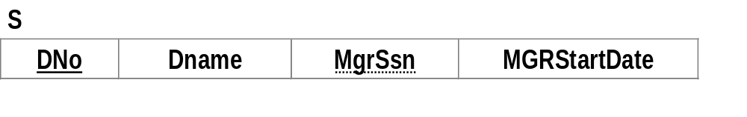
Example:
  Participating entity types: DEPARTMENT, EMPLOYEE
  Mapped to Relations S and T
  DEPARTMENT (total participation in MANAGES)
  Primary Key of T becomes Foreign key for S: MGRSSN (primary key of EMPLOYEE)
  Simple attributes for S: StartDate of MANAGES (renamed as MGRStartDate)
1
1
EMPLOYEE
MANAGES
DEPARTMENT
Ssn
StartDate

Slide 30
Step 4: 1:N Relationship Types
For each regular (non-weak) binary 1:N relationship type R_{b}:
  Identify relation S that represents participating entity type at 1-side of relationship type R_{b}
  Include primary key of S as foreign key of other participating relation T (N-side)
  Include any simple attributes of R_{b} as attributes of T
  1:N relationship type: WORKS_FOR, SUPERVISION and CONTROLS

Slide 31
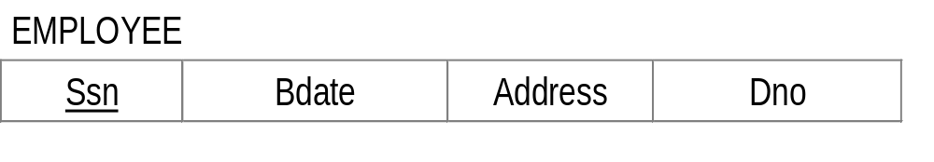
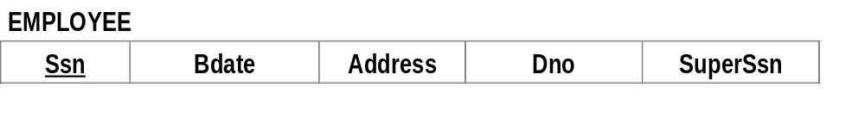
Example:
  Foreign key for EMPLOYEE (WORKS_FOR relationship): DNo (primary key of DEPARTMENTS)
N
WORKS_
FOR
1
EMPLOYEE
DEPARTMENT
Ssn
Dno
FK
Foreign key for EMPLOYEE (SUPERVISION relationship): SUPERSSN (primary key of EMPLOYEE)
FK
FK

Slide 32
Step 5: M:N relationship types
For each binary M:N relationship type R_{b}:
  Create a new relation R to represent R_{b}
  Include as foreign key of R the primary keys of relations (corresponding to participating entities of R_{b})
  Combination of foreign keys will be primary key of R
M
WORKS_
ON
N
EMPLOYEE
PROJECT
Ssn
Pno
Hours

Slide 33
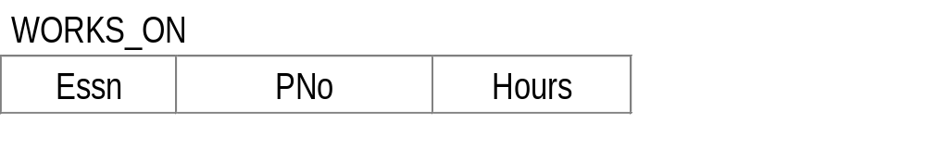
Example:
  M:N Relationship type: WORKS_ON
  Relation created: WORKS_ON
  Foreign key for WORK_ON: PNo (from PROJECT) and ESSN (from EMPLOYEE)
  Primary key for WORKS_ON: {PNo, ESSN}
  Attribute: Hours

Slide 34
Step 6: Multivalued Attributes
For each multivalued attribute A:
  Create a new relation R that includes an attribute corresponding to A and primary key of entity type or relationship type that has A as an attribute
Example:
  Multivalued attribute: Location
  Relation created: DEPT_LOCATION
  Attribute: DLocation
  Foreign key: DNo (primary key of DEPARTMENT)
  Primary key: {DNo, DLocation}

Slide 35
Step 7: n-ary Relationship Types
For each n-ary relationship R_{n} (degree greater than 2):
  Create a new relation R to represent R_{n}
  Include as foreign keys to R primary keys of relations (corresponding to participating entity types)
  Include any simple attributes of R_{n} as attributes of R
  Primary key of R is combination of foreign keys that reference the relations (corresponding to participating entity types)
  If participation constraint (min, max) of one participating entity type E in R_{n} has max=1, primary key of R can be single foreign key that references relation T corresponding to entity type E

Slide 36
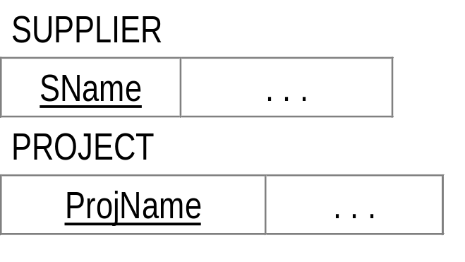
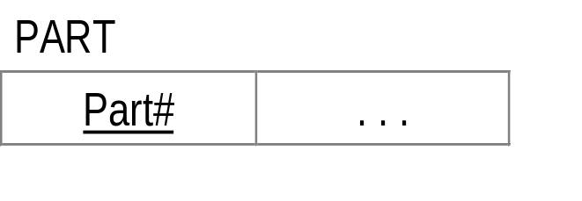
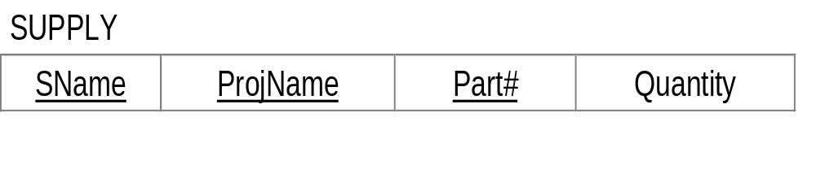
Example: ER diagram showing an n-ary relationship
Corresponding relations:
SName
Quantity
SUPPLIER
SUPPLY
PROJECT
ProjName
Part#
PART

Slide 37

Step 8: Class Hierarchies
Convert each specialization with m subclasses {S₁,S₂,…,S_{m}} and (generalized) superclass C, where attributes of C are {k, a₁, a₂, …, a_{n}} and k is the (primary) key, into relation schemas using one of the following options:
Option 8A:
  Create a relation L for C with attributes Attrs(L) = {k, a₁, a₂, …, a_{n}} and PK(L) = k
  Also create a relation L_{i} for each subclass S_{i}, 1 <= i <= m, with attributes: Attrs(L_{i}) = {k} U {attributes of S_{i}} and PK(L_{i}) = k

Slide 38
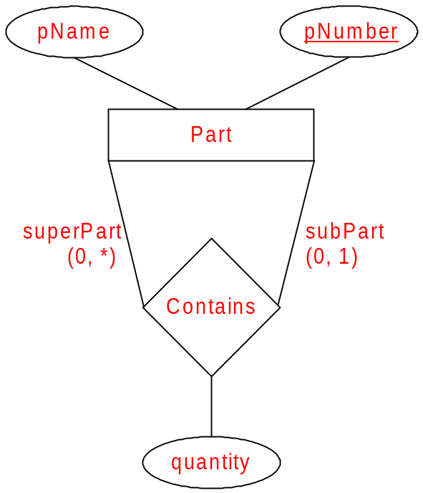
Example:
Part (pName, pNumber)
Contains (superPart, subPart, quantity)
PRIMARY KEY (Part) = <pNumber>
PRIMARY KEY (Contains) = <subPart>
FOREIGN KEY Contains (superPart) REFERENCES Part (pNumber)
FOREIGN KEY Contains (subPart) REFERENCES Part (pNumber)

Slide 39
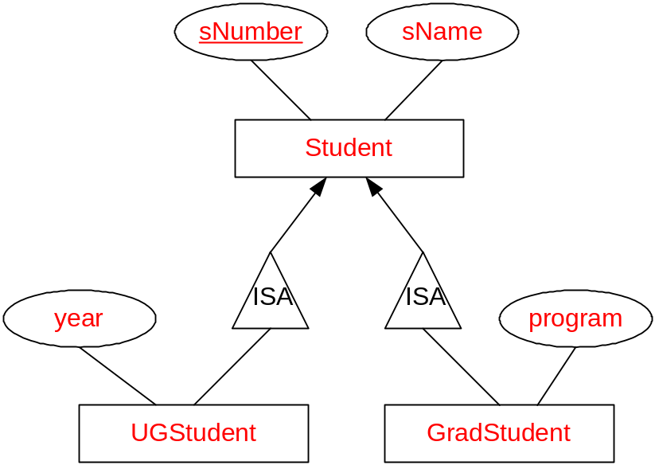
ISA Relationship types: Method 1
Student (sNumber, sName)
UGStudent (sNumber, year)
GradStudent (sNumber, program)
PRIMARY KEY (Student) = <sNumber>
PRIMARY KEY (UGStudent) = <sNumber>
PRIMARY KEY (GradStudent) = <sNumber>
FOREIGN KEY UGStudent (sNumber)
REFERENCES Student (sNumber)
FOREIGN KEY UGStudent (sNumber)
REFERENCES Student (sNumber)
An UGStudent will be represented in both Student relation as well as UGStudent relation (similarly GradStudent)

Slide 40
ISA Relationship types: Method 2
Student (sNumber, sName, year, program)
PRIMARY KEY (Student) = <sNumber>
Note: There will be null values in the relation.

Slide 41
ISA Relationship types: Method 3
Student (sNumber, sName)
UGStudent (sNumber, sName, year)
GradStudent (sNumber, sName, program)
UGGradStudent (sNumber, sName,
year, program)
PRIMARY KEY (Student) = <sNumber>
PRIMARY KEY (UGStudent) = <sNumber>
PRIMARY KEY (GradStudent) = <sNumber>
PRIMARY KEY (UGGradStudent) = <sNumber>
Any student will be represented in only one of the relations as appropriate.

Slide 42
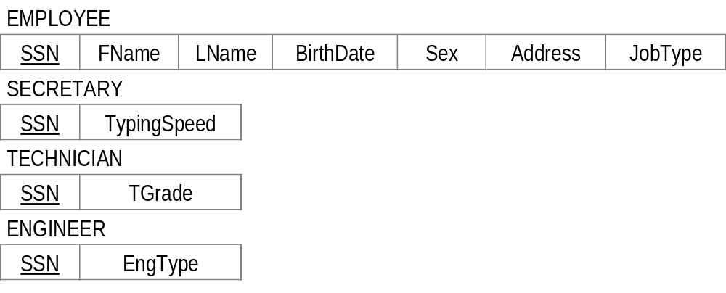
Example:
LastName
FirstName
BirthDate
Address
Name
SSN
Sex
EMPLOYEE
JobType
JobType
d
“Engineer”
“Secretary”
“Technician”
ENGINEER
TECHNICIAN
SECRETARY
Type
Grade
TypingSpeed

Slide 43
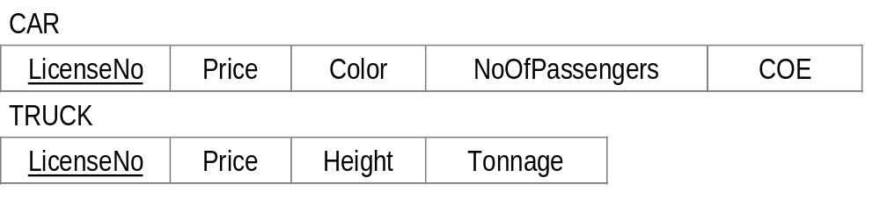
Option 8B:
  Create a relation L_{i} for each subclass S_{i}, 1 <= i <= m, with attributes: Attrs(L_{i}) = {attributes of S_{i}} U {k, a₁, a₂, …, a_{n}} and PK(L_{i}) = k
Price
LicenseNo
VEHICLE
Applies to TOTAL &
DISJOINT constraints
Tonnage
Color
d
CAR
TRUCK
Height
NoOfPassengers
COE

Slide 44
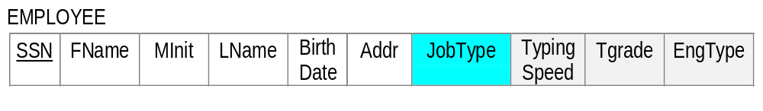
Option 8C:
  This option is for a specialization whose subclasses are disjoint, and t is a type attribute that indicates the subclass to which each tuple belongs, if any
  Create a single relation L with attributes: Attrs(L) = {k, a₁, a₂, …, a_{n}} U {attributes of S₁} U …U {attributes of S_{m}} U {t} and PK(L) = k
Example:
  JobType playing the role of type attribute
Only 1 will be non-null

Slide 45
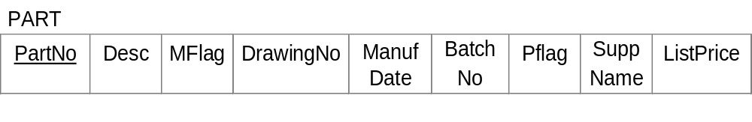
Option 8D:
  This option is for a specialization whose subclasses are overlapping (not disjoint), and each t_{i}, 1 <= i <= m, is a boolean attribute to indicate whether or not a tuple belongs to subclass S_{i}
  Create a single relation L with attributes: Attrs(L) = {k, a₁, a₂, …, a_{n}} U {attributes of S₁} U ... U {attributes of S_{m}} U {t₁, t₂, …, t_{m}} and PK(L) = k
  This option has a potential to generate a large number of null values
Example:

Slide 46
Step 9: Translating Aggregations
Within the aggregation, create relations to represent entities/relationship
Create relation to represent relationship between aggregation and entity
CUSTOMER
1
N
BORROWS
LOAN
N
ARRANGED-BY
M
BANK-OFFICER

Slide 47
With reference to ER Model, relations created are:
  CUSTOMER(Ic-No, CustName, Address, …)
  LOAN(LoanNo, IC-No, Amount)
  BANK-OFFICER(EmpNo, Name, TelNo)
  ARRANGED-BY(IcNo, LoanNo, EmpNo)

Slide 48
Relational Schema Derived from ER Diagram
EMP
SSN
FName
Minit
LName
BirthDate
Addr
Sex
Salary
SuperSSN
Dno
PK
FK
FK
Steps 1 & 4
DEPT
Steps 1 & 3
DNumber
DName
MgrSSN
MgrStartDate
PK
FK
FK
FK
WORKS_ON
ESSN
PNo
Hours
PROJECT
PNumber
PName
DNo
PLocation
PK
Steps 5
PK
FK
FK
Steps 1 & 4
DEPT_LOC
DNumber
DLocation
Steps 2
PK
DEPENDENT (FK is ESSN)
Steps 6
ESSN
DependentName
Sex
BDate
Relationship
PK

Slide 49
O
C
C
U
i
N
N
L
S
O
At this stage, you should
Know the meaning of : Domain, Relation …..
Differentiate between different types of keys
Understand each integrity constraint
Able to map an EER diagram into relational tables

Slide 50
Why are DOMAINs hard to implement?
1. Cross domain comparison
e.g. FIND STUDENT WHERE BIRTHDATE =‘010170’
2. Some inter-domain comparisons may not make sense
e.g. FIND STUDENT WHERE SEX <‘M’
3. Possible to combine vales from diff. Domains
e.g. VELOCITY x TIME = DISTANCE

Slide 51
Relationship between various KEYS
Superkey
Candidate
key
PK
Alternate keys

Slide 52
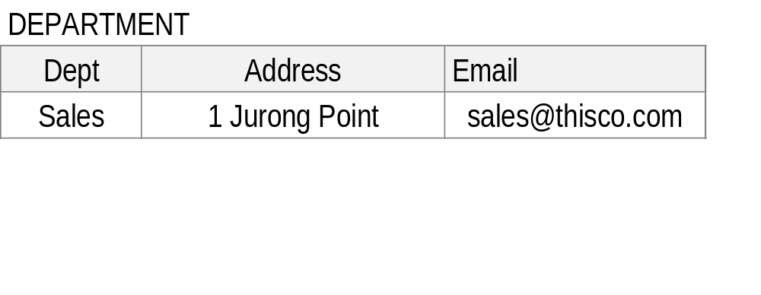
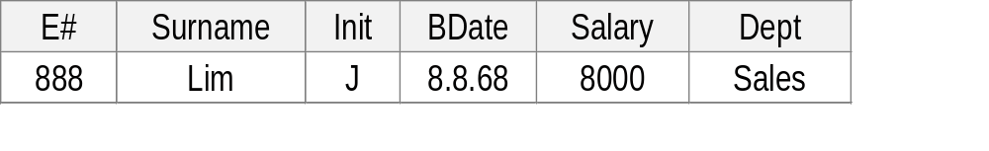
PK
EMPLOYEE
FK
1. Cascades - Delete Dept ‘SALES’ results in ALL employees in this
Dept
2. Restricted - CANNOT delete ‘SALES’ if there are employees in that Dept
3. Nullifies - set DEPT of employee 888 to null when SALES deleted

Slide 53
